Slide 1
Warehouse Management (WM)
Curriculum: Introduction to S/4HANA using Global Bike

Slide 2

4.3 (July 2025)
SAP S/4HANA 2023
Fiori 3.0
Global Bike
No Prerequisites needed

Slide 3
Chris Bernhardt
Babett Ruß
Beginner

Slide 4
You are able to
name some functionalities of the WM module.
define the central organizational structures of the WM module.
summarize the master data which is most important for the WM module.
explain standard Warehouse Management processes.

Slide 5
Functionality
Goods Receipt
Goods Issue
Picking
Packing
Shipping
Physical Inventory

Slide 6
Agenda
WM Organizational Structure
WM Master Data
WM Process Management and Control

Slide 7
Agenda
WM Organizational Structure
WM Master Data
WM Process Management and Control

Slide 8
WM Organizational Structure
Global Bike
Client
Global Bike Inc. US
Global Bike Inc. DE
Company Code
Dallas
San Diego
Miami
Plant
Trading Goods
Finished Goods
Miscellaneous
Storage
Location
San Diego Warehouse
Warehouse
Number
Shelf Storage
GR Area Ext.
Receipts
Pallet Storage
Shipping area
Deliveries
Stock Transfers
(Plant)
Storage Type
Total Section
Storage Section

Slide 9
WM Organizational Structure
Client
  An independent environment in the system
Company Code
  Smallest organisational unit for which you can maintain a legal set of books
Plant
  Operating area or branch within a company
    Manufacturing, distribution, purchasing or maintenance facility
Storage Location
  An organizational unit allowing differentiation between the various stocks of a material in a plant

Slide 10
WM Organizational Structure
Warehouse Number
  Number that identifies a complex, physical warehouse structure within the warehouse management system
Storage Type
  Subdivision of a complex, physical warehouse
  Is identified by its warehousing technique, form of organization, or its function
Storage Section
  Logical or physical subdivision of a storage type
  Groups together a series of similar storage bins
Picking Area
  Groups storage bins together from the standpoint of picking strategies

Slide 11
WM Organizational Structure
Warehouse door
  Marks the point where the means of transport changes to an internal transportation
Allocation Zone
  Temporary storage of goods, which have just arrived or will be shipped soon
Shipping Point
  Is the part of the company responsible for the type of shipping, the necessary shipping materials and the means of transport
Storage Bin
  Smallest addressable unit in a warehouse, which identifies the exact location in the warehouse where goods can be stored
  → Master Data

Slide 12
Global Bike Structure for Warehouse Management
Global Bike
Client
Global Bike Inc. US
Global Bike Inc. DE
Company Code
Dallas
San Diego
Miami
Plant
Trading Goods
Finished Goods
Miscellaneous
Storage
Location
San Diego Warehouse
Warehouse
Number
Shelf Storage
GR Area Ext.
Receipts
Pallet Storage
Shipping area
Deliveries
Stock Transfers
(Plant)
Storage Type
Total Section
Storage Section
STBN-2-000
STBN-2-001
STBN-2-999
Storage Bin

Slide 13
Global Bike Enterprise Structure in SAP ERP (Logistics)
Shipping Point
DL00
MI00
SD00
TO00
HD00
HH00
PE00
RM00
TG00
TG00
TG00
RM00
TG00
TG00
Storage
Location
SF00
FG00
FG00
FG00
SF00
FG00
FG00
FG00
MI00
MI00
MI00
FG00
MI00
MI00
MI00
MI00
Central Purchasing Organization (global) GL00
Purchasing Org. US00
CA00
PO DE00
AU00
Purchasing Group North America
N00
PGr Europe
E00
Asia
A00
Dallas
DL00
Miami
MI00
S. Diego
SD00
Toronto
TO00
Heidelb.
HD00
Hamburg
HH00
Perth
PE00
Plant
CC US00
CA00
CC DE00
AU00
Company Code
Client Global Bike
Notes:
Organizational units displayed in grey are not yet implemented, but are already planned in Global Bike.

Slide 14
Agenda
WM Organizational Structure
WM Master Data
WM Process Management and Control

Slide 15
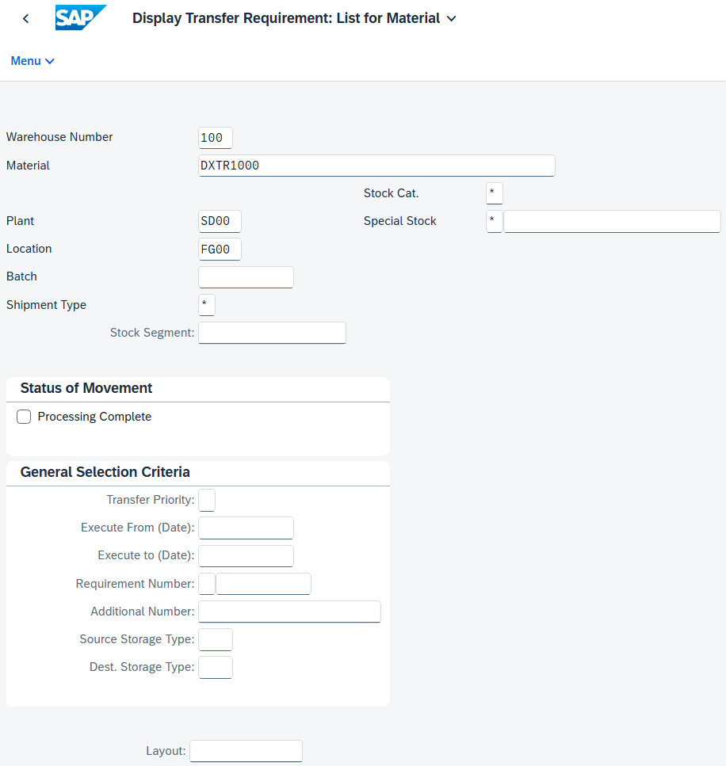
WM Master Data
Storage Bin Master Data
Material Master Data
Hazard Master Data
Batch Master Data

Slide 16
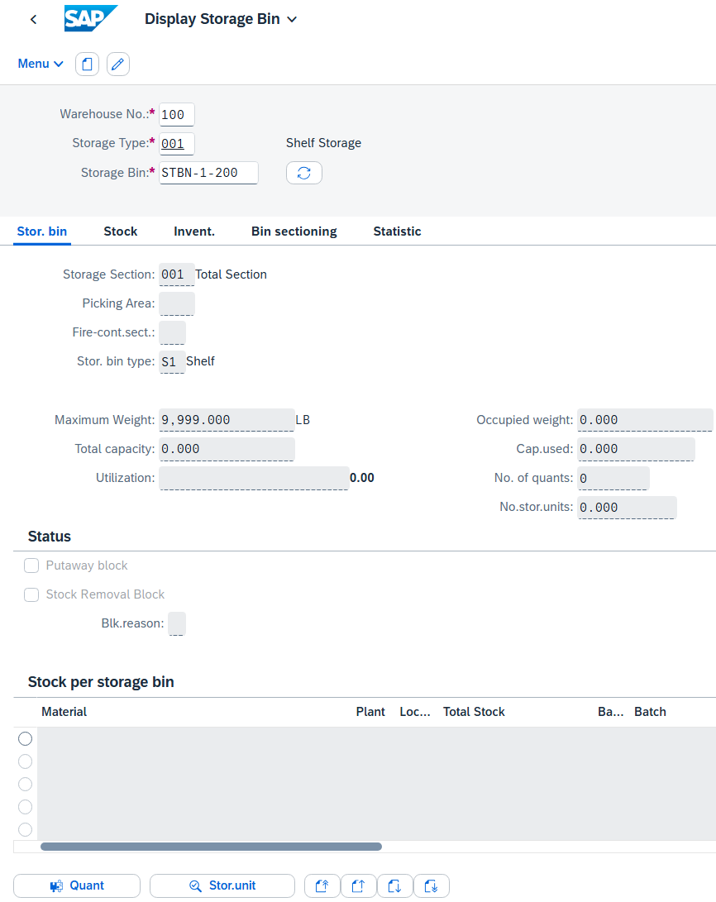
Storage Bin Master Data
Storage Bin Master Data
  Two different organizational levels
    Warehouse Level:
    All indicators and fields which are valid for the whole warehouse
    Storage Type Level:
    All indicators which are only valid for specific storage types
  Also includes Storage Bins and Quants

Slide 17
Storage Bin Master Data
Storage Bin: Smallest addressable unit in a warehouse
  General Data
    Warehouse
    Storage type
    Storage bin number
  Storage Bin Data
    Storage section
    Picking area
    Fire-containment section
    Bin type
    Max. weight
    Total capacity
  Status
    Blocked for putaway
    Stock removal block
    Blocking reason
General Data
Storage Bin Data (WM)
Status (MM)

Slide 18
Storage Bin Master Data
Quant: Smallest addressable unit of measure for a material in SAP S/4HANA
  General Data
    Material
    Plant / Storage location
    Batch
    Warehouse
    Storage type
    Storage bin
  Stock Data
    Total stock
    Available stock
  Block Indicator
    Block
    Putaway/removal status
General Data
Stock Data (MM)
Blocking Indicator (MM)

Slide 19
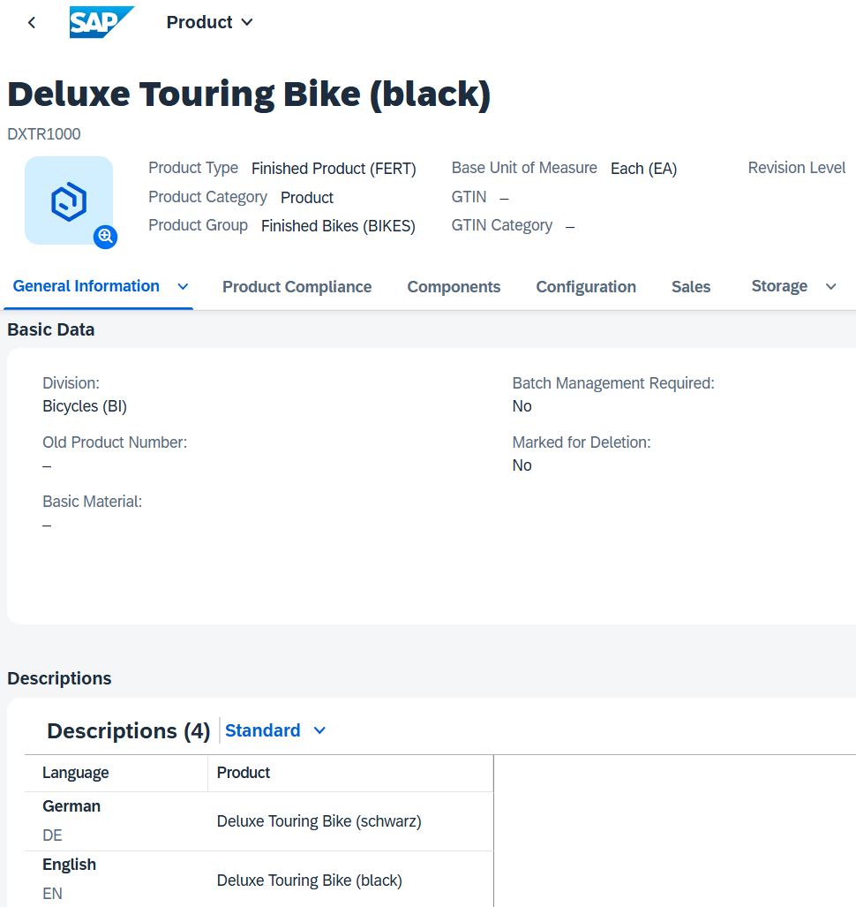
Material Master Data
Material Master
  Contains all the information a company needs to manage a material
  It is used by most components within the SAP system
    Sales and Distribution
    Materials Management
    Production
    Plant Maintenance
    Accounting/Controlling
    Quality Management
  Material master data is stored in functional segments called Views

Slide 20
Material Master Views
Sales Data
Basic Data
Warehouse Mgmt.
Material Master
Mat. Plan. Data
Forecasting Data
Storage Data
Controlling Data
Quality Data
Accounting Data

Slide 21
Material Master
General Information relevant for the entire organization:
Name
Weight
Unit of Measure
Client XXX
Sales specific information:
Delivering Plant
Loading Grp
Storage Location specific information:
Stock Qty
Sales Org. UW00
Storage Loc. FG00
Sales Org. UE00
Storage Loc. TG00
Notes:
All of this together makes up the Master Record for a Material.

Slide 22
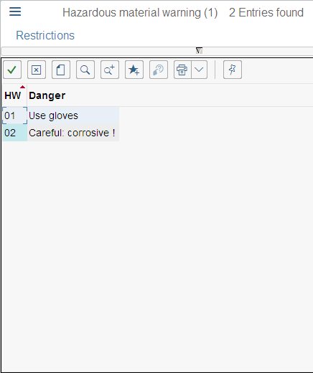
Hazard Master Data
Storage area for hazardous materials
  Flammable liquids
  Toxic materials
  Radioactive materials
General Data
  Storage class
  Water pollution class
  Flash point
  Aggregate state
  Hazardous material warning
  Hazardous substance number

Slide 23
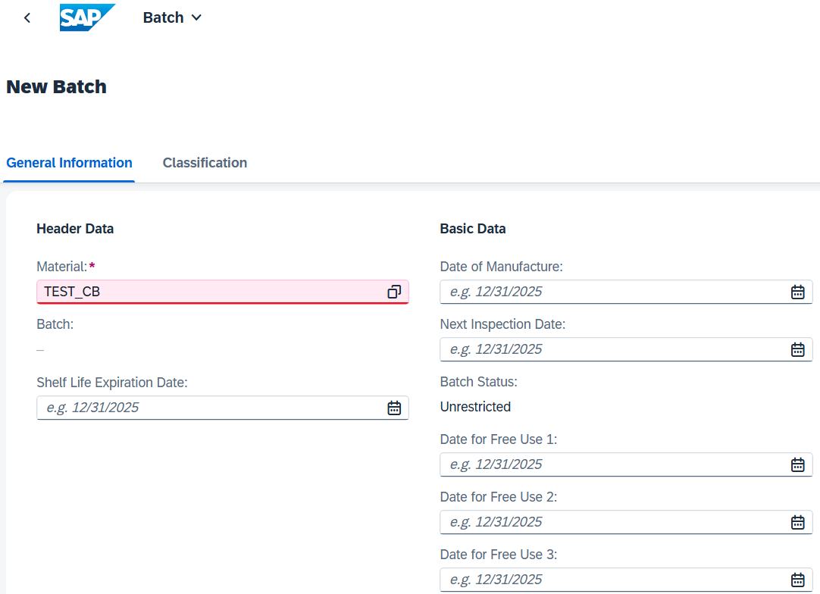
Batch Master Data
Subset of Material
  homogeneous series of unreproducible units with a unique
  specification
Basic Data 1 & 2
  Expiration date
  Inspection date
  Trading data
  Administration data
  Text data
Classification of Batch
Material data

Slide 24
Agenda
WM Organizational Structure
WM Master Data
WM Process Management and Control

Slide 25
WM Types of goods movements
Plant 1
Plant 2
Storage Loc. 1
Storage
location 2
Vendor
Production
Unrestricted-
use stock
Stock in quality inspection
Storage
location 3
Production
Customer
Blocked stock

Slide 26
Transfer posting and stock transfer
Transfer posting
Change to stock type,
material number or batch
number
Additional physical material
movement possible
Stock to stock
Material to material
Consignment to warehouse
Stock transfer
Physical material
movement
Once- and two-step
procedures possible
Stor. loc to stor. loc
Plant to plant
Company code to company code

Slide 27
One-Step/Two-Step Procedures
Issuing organizational level
Receiving organisational level
Stock
Stock in
transfer
Step 1: Remove fr. storage
Step 2: Place in storage
Step 1: Remove fr. storage
+
Step 2: Place in storage
Stock

Slide 28
Stock transport order
A Stock Transport Order (STO) is a purchase order used to request or instruct a plant to transport material from one plant to another (that is, to effect a long distance physical stock transfer) within the same corporate enterprise.
The stock transport order allows delivery costs incurred as a result of the stock transfer to be charged to the material transported.
Issuing plant
Receiving plant
Storage location
Stock transp.
order
Unrestricted-
use stock
Storage Loc
Unrestr.-use
stock
Stock in
transit
Stock in
quality insp.
Blocked
stock

Slide 29
WM Processes
Logistics Execution
Goods receipt
Goods issue
Goods receipt posting
Goods issue posting
Transfer requirement
Transfer requirement
Putaway with
transfer order
Picking with
transfer order
Confirm transfer order
Confirm transfer order

Slide 30
WM Process Management and Control
Posting change notice (PCN)
  Generated by posting change processes in WM-administrated stocks
  Functionality similar to transfer requests
  Not necessarily combined with a physical goods movement
Transfer requirement (TR)
  A request to transfer materials at a particular time from a source storage bin to a destination storage bin in a warehouse complex
  Represents the expected and scheduled goods movements in WM
  Normally generated by postings in the inventory management
  Consists of transfer request header and line items
Transfer order (TO)
  Central documents for WM
  Every material movement requires a transfer order
  No difference between real and logical movement

Slide 31
Transfer Order
Creation of transfer order depends on preceding document
  Transfer request
  Posting change notice
  Outbound delivery
  Inbound delivery
Types of Transfer Order Creation
  Manual (TR, PCN, material document)
  Direct TO-Creation
  Automatic TO-Creation
  Manual (Delivery Monitor)

Slide 32
Inventory
Periodic inventory
Continuous inventory
Inventory on putaway
Zero stock check
Sample-based physical inventory
Cycle-Counting
Notes:
Cycle-Counting is based on an ABC-Analysis

Slide 33
Physical inventory process
Create physical inventory document
Activate physical inventory document
Print warehouse inventory list
Enter count results
Clear differences in the warehouse management
Clear the differences in the inventory management
Notes:
Create physical inventory document -> Flag storage bins for inventory
Activate physical inventory document -> Storage bins are blocked
Print warehouse inventory list -> Inventory report RLLI0400
Enter count results -> Get differences
Clear differences in the warehouse management -> Release storage bins
Clear the differences in the inventory management -> Create material document and accounting document

